Slide 1
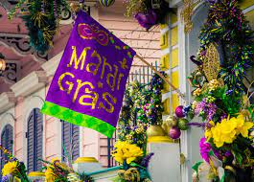
2021 Southeastern TB Controllers Meeting
Alabama Update

Slide 2

Mardi Gras
The celebration of Mardi Gras started 1703 by Frenchman Nicholas Langlois in Mobile, Alabama.
It is the oldest Carnival of celebration in the United States.
Mardi Gras dates changes, because it’s connected to Easter.

Slide 3

Successes
Emocha implementation
Creation of TB Surveillance Unit lead by TB Epidemiologist
Public Health Associate assigned by CDC

Slide 4

Challenges
Competing priorities of assisting with COVID-19 response efforts including clinic and investigation, while continuing to maintain TB duties.

Slide 5

Upcoming Projects/Initiatives for the New Year
Workforce Development initiative (expanding and supporting DIS workforce)
COVID Vaccine Unit (partnership with Immunization Division)
Community partnership expansion (developing and strengthening partnerships with various agencies and CBOs throughout the state who serve high-risk TB populations)

